Slide 1
Question-3
Oct 3
Dejan

Slide 2
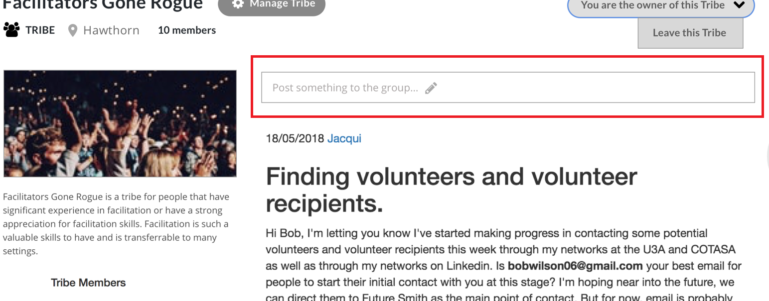
Q1: Post a discussion
1-1: I don’t understand how to post a discussion with this screen.
This screen has only one input text.
A discussion has title, content.
And we need a publish button for posting a discussion.
So can you explain how to create a discussion on this screen with only one input text?

